Slide 1
Sentiment Analysis with LSTMs

Slide 2
Agenda
Why sentiment analysis (SA)?
What is sentiment analysis?
Solving sentiment analysis as a sequential task
Introduction to deep sequential models
Inside an LSTM
Implementing a SA LSTM network with Keras
Evaluating performance
Comparing the results to RNNs

Slide 3
Why sentiment analysis?
Given a phrase/sentence/short paragraph extracting whether the corpus carry a positive/negative/neutral sentiment
Examples:
I liked that movie a lot – Positive
The movie was an utter disappointment – Negative
It was okey – Neurtral

Slide 4
Applications
Improving products and services
Detect suicidal thoughts/depression in social media posts
Movie recommendation

Slide 5
Challenges
Double negation: I do not dislike that movie
Difference in word ordering: That movie was great, not
Sarcasm: I enjoyed the late delivery of it so much!

Slide 6
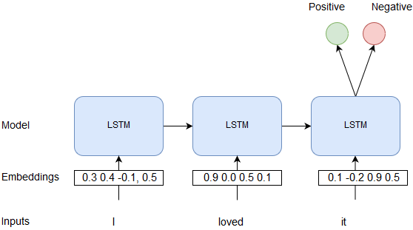
What is sentiment analysis?

Slide 7
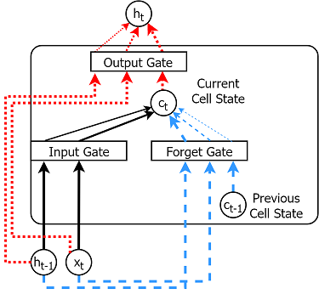
Introduction to deep sequential models
Deep sequential models
RNNs
LSTMs
GRUs
Tasks
Sentiment analysis
Machine translation
Chatbots
Image caption generation

Slide 8
LSTM at an abstract level
Input
an input coming into the cell (e.g. a word vector)
Cell state
The internal cell state (i.e. memory)
Output/Hidden state
A hidden state used to compute the final prediction
Input gate
How much of current input read into the cell state
Forget gate
How much of previous cell state (t-1) is read into the current cell state (t)
Output gate
How much of the cell state filters through as the output

Slide 9
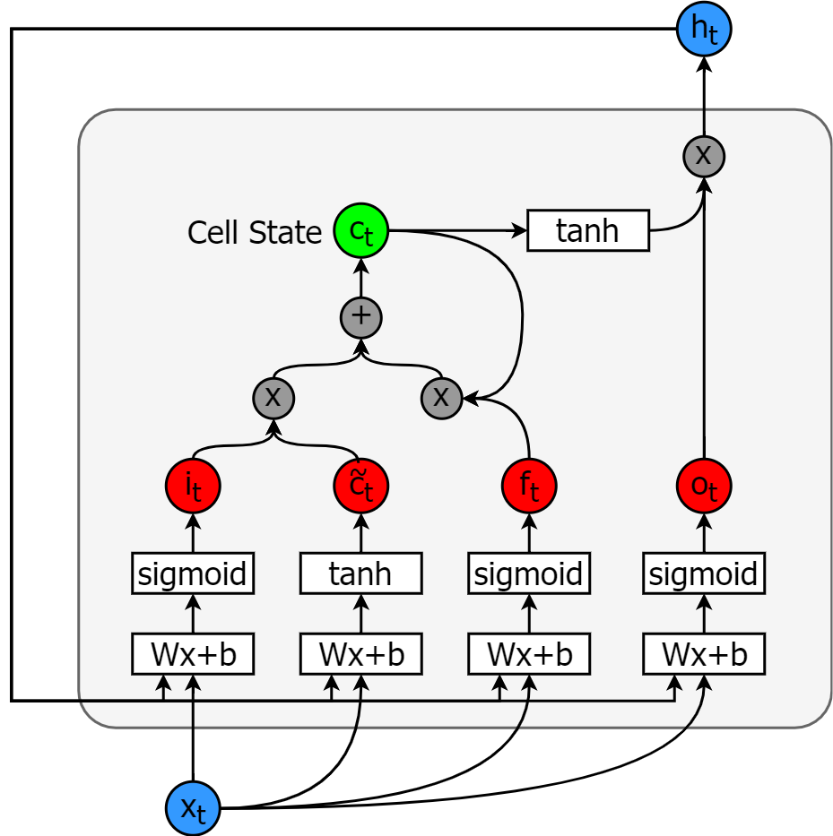
LSTM more concretely
More info: Refer chapter 7 of “Natural language processing with TensorFlow”
Input gate
Determines how much of current input and previous output goes through
Forget gate
Determines how much of current input and previous output is forgotten
Memory cell
Computed as a sum of information coming through input gate, and previous value of memory cell
Output gate
Determines how much current input and previous output contributes to the output
Output
Memory cell output multiplied by output gate

Slide 10
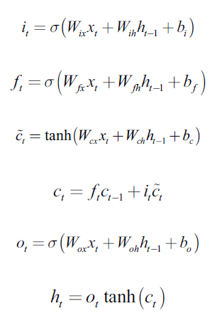
Computations in an LSTM cell
Input gate
Forget gate
Cell memory
Output gate
Output

Slide 11
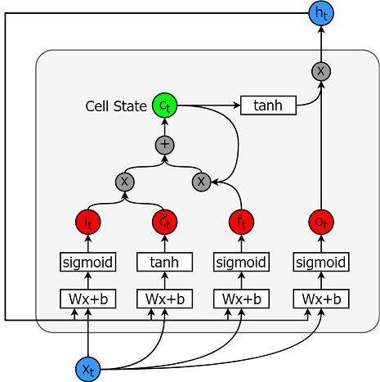
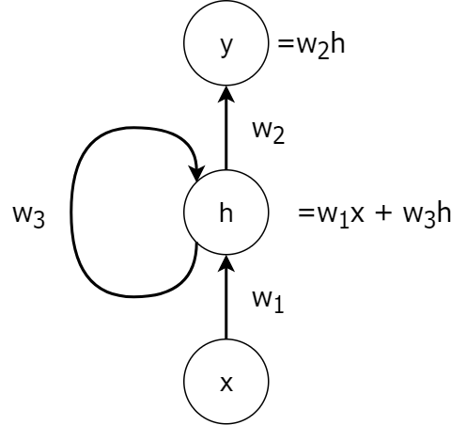
Difference between a RNN and an LSTM

Slide 12
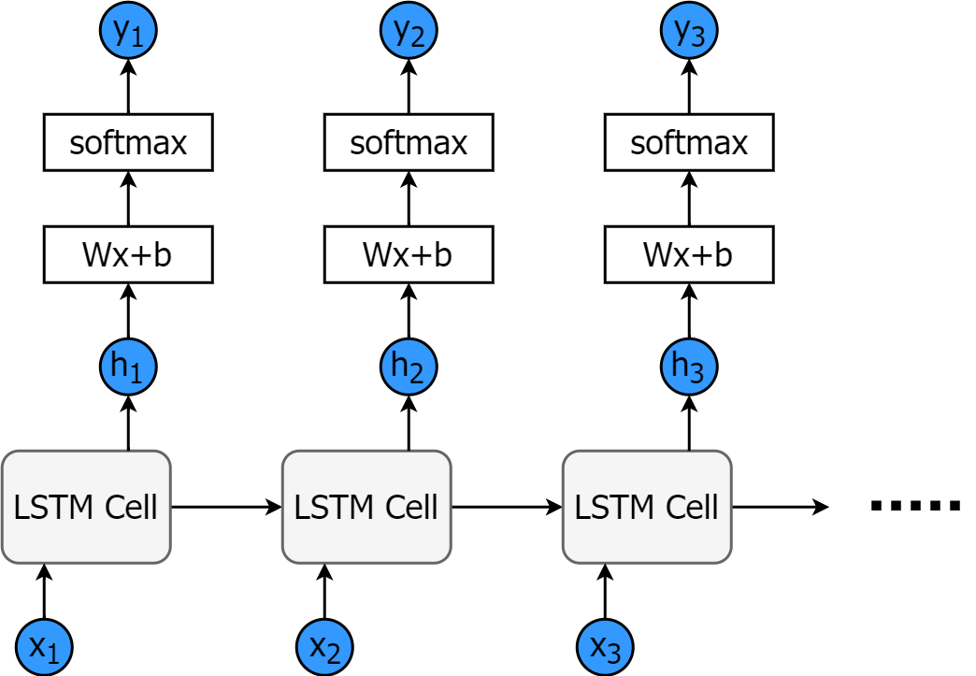
Using LSTMs for prediction
LSTMs are not very useful without a prediction layer on top
Therefore we use a Softmax layer on top

Slide 13
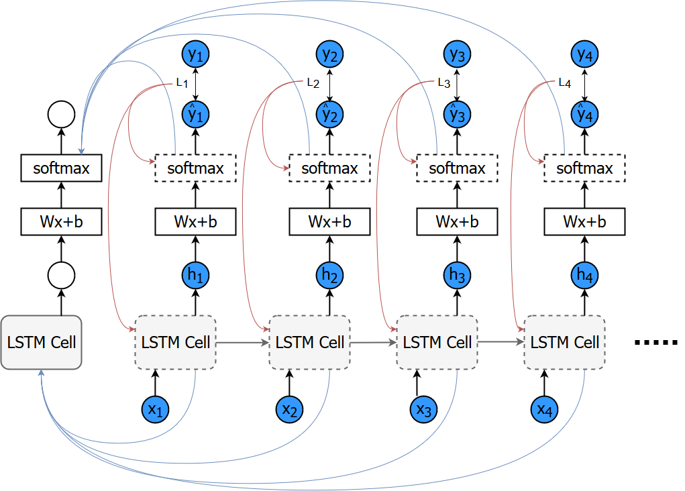
Training LSTMs
More info: Refer chapter 6 and 7 of “Natural language processing with TensorFlow”
In order to train an LSTM we perform “unrolling”
Then the gradients are computed for each step
Finally the gradients are summed up to perform backpropagation
Any limitations with this approach?

Slide 14
Vanishing gradient and Exploding gradient
More info: Refer chapter 6 and 7 of “Natural language processing with TensorFlow”
Gradients can vanish/explode depending on the way the weights are initialized
Likelihood of vanishing/exploding gradients increases with longer sequences
How to solve the exploding gradient?
How to solve vanishing greadients?

Slide 15
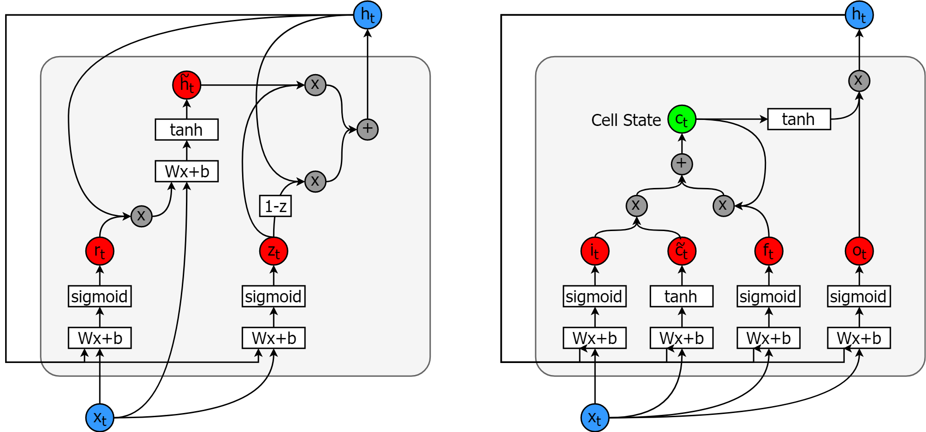
Are there better/simpler alternatives?
More info: Refer chapter 7 of “Natural language processing with TensorFlow”
Gated Recurrent Units is one simpler well-performing alternative for LSTMs

Slide 16
Implementing a sentiment analyser

Slide 17
Introduction to data
Positive reviews
Sometimes it takes a film-making master like Kubrick to bring that extra little something, …
A classy film pulled in 2 directions. To its advantage it is directed by Wes Craven. …
I find this movie very enjoyable. The plot is simple and easily digestible, the humour is light and …
Negative reviews
Even for the cocaine laced 1980's this is a pathetic. I don't understand why someone would want to …
I watched this hoping to find out something I didn`t know about modern history`s most infamous man a …
Saw this movie when it first came out in the 1970's and hated, hated, hated it! Easily the most …

Slide 18

Preprocessing text
Fitting a tokenizer
Transforming to sequences and padding
Why do we need padding?

Slide 19
Defining the sentiment analyser
Input layer
Embedding layer
LSTM layer
Prediction layer

Slide 20
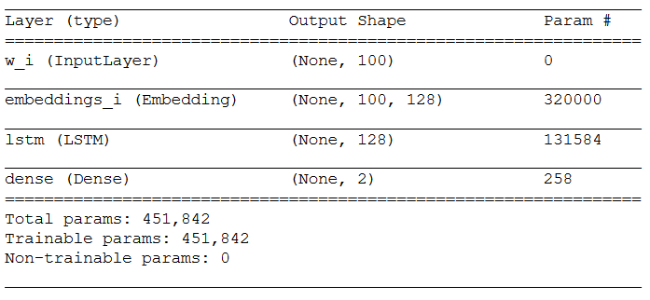
Defining the full model

Slide 21
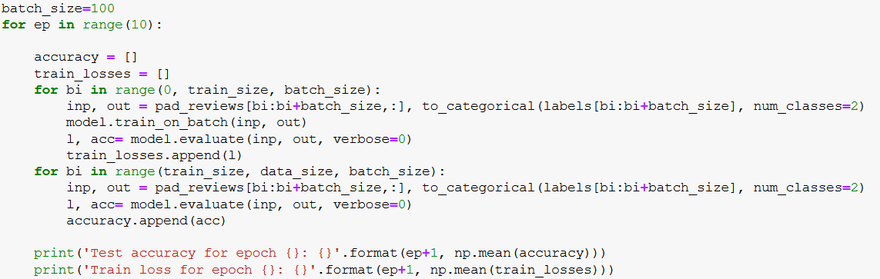
Training the sentiment analyser

Slide 22
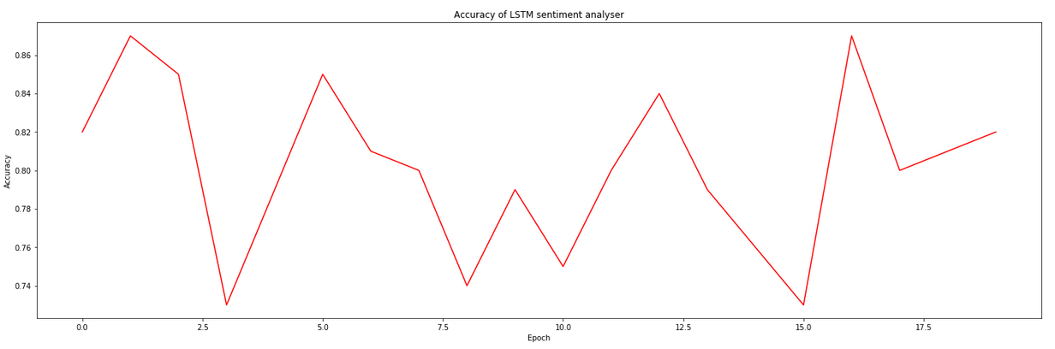
Evaluating results

Slide 23
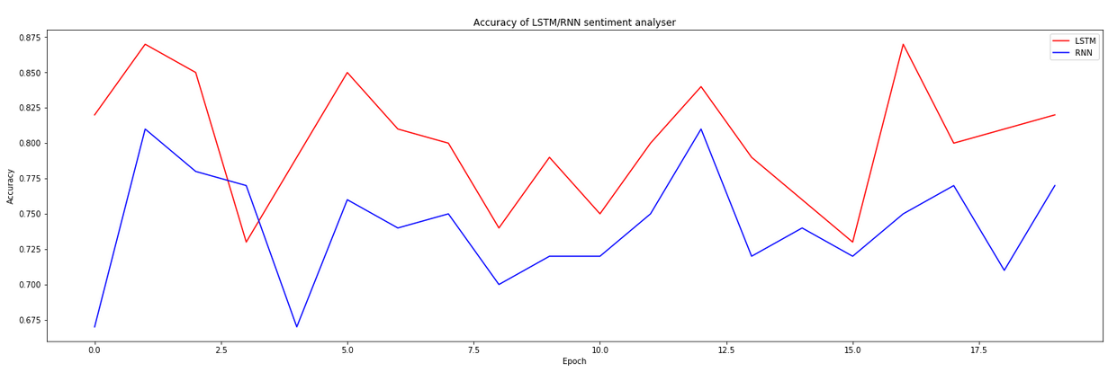
Comparing with a RNN
Which one is better? And why?

Slide 24
Improving LSTM performance
Data shuffling for every epoch
Subsampling words
Deep LSTMs
Bidirectional LSTMs
More info: Refer chapter 7 of “Natural language processing with TensorFlow”

Slide 25
Conclusion
Applications/challenges of sentiment analysis
What is sentiment analysis
How LSTMs work?
Other alternatives to LSTMs?
Implementing a sentiment analyser with Keras
Running/Training the model
Evaluating the model
Comparing the results with a RNN

